Slide 1

Robotic Cell Layouts
Dr Anjan Kumar Dash

Slide 2
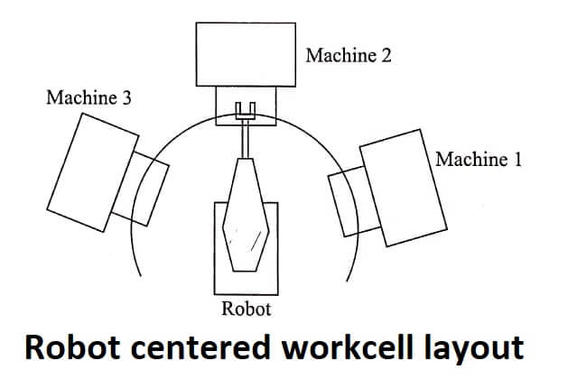
Robot centered workcell
In-line robot workcell
Mobile robot workcell
Example: Machining, die casting, plastic molding
https://theteche.com/robot-cell-layouts-theteche-com/

Slide 3
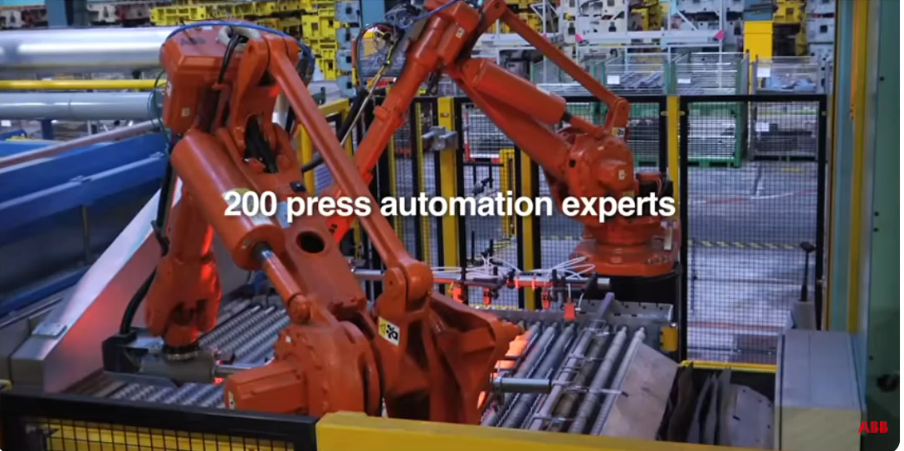

Slide 4
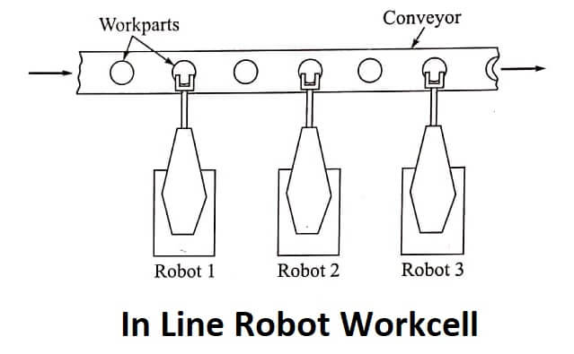
https://theteche.com/robot-cell-layouts-theteche-com/

Slide 5
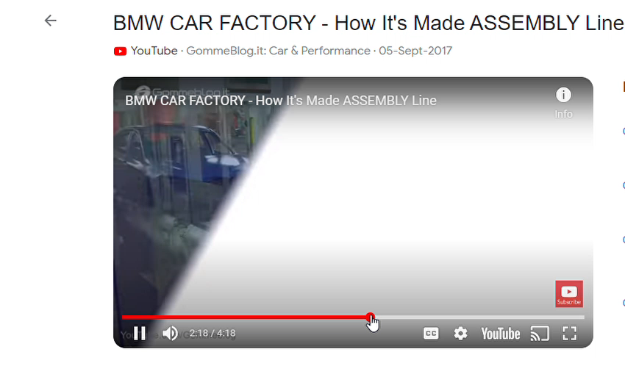
Intermittent transfer
Continuous transfer
Non-synchronous transfer

Slide 6
Intermittent transfer system ( Robot is fixed, the objects come to its location)
Continuous transfer system (Robot is in motion while it is doing its task on the object moving on the conveyer)
Moving baseline tracking system
The robot itself moves along side the conveyer on which the workpiece is moving
Extra DOF is to be given to the robot, may be by a rail parallel to the conveyer
Needs extra space, costly, potential interference between robots
Stationary baseline tracking system
Robot base is fixed, but its manipulator can move along side the conveyer
Needs to move the manipulator at a speed same as conveyer-control and computing ability
Tracking window must capture the end-effecter and the portion of the w/p where operation is to be performed

Slide 7
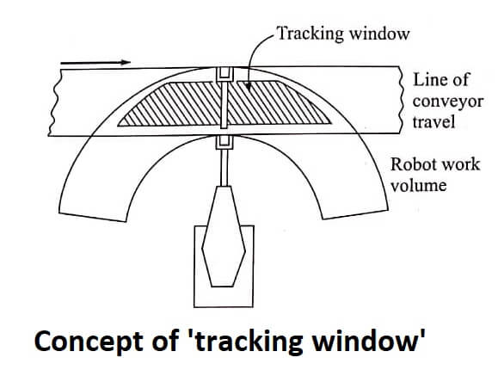
Total motion cycle must
be captured within the tracking
window.
Sensing the part on the conveyer
Non-synchronous transfer
Power-and-free: each part moves
independently along the conveyer
in a manner stop-and-go fashion
https://theteche.com/robot-cell-layouts-theteche-com/

Slide 8
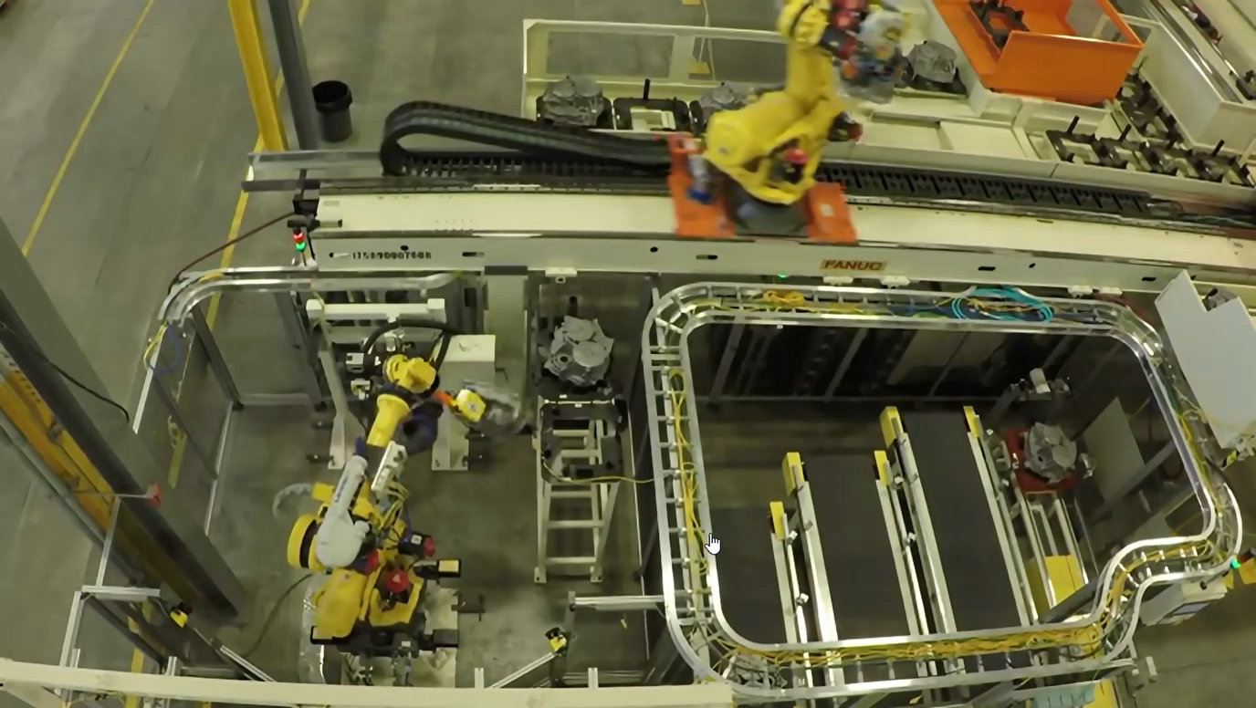
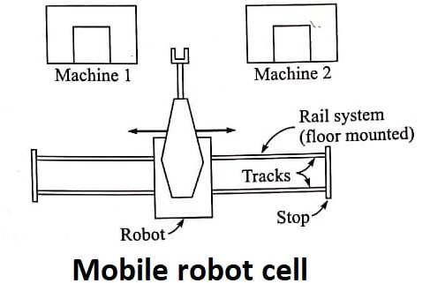
https://theteche.com/robot-cell-layouts-theteche-com/
From you tube

Slide 9
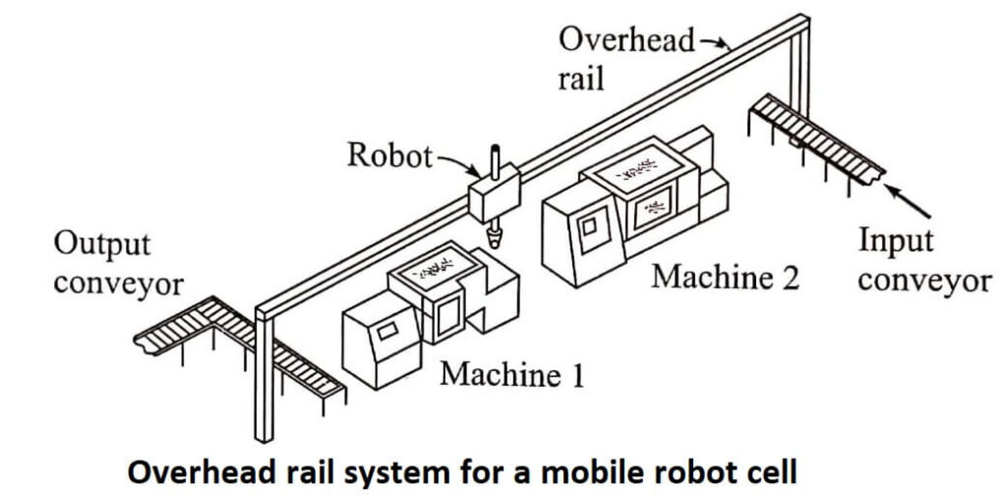
Better when the
robot is to serve
several machines
with long process time
A separate robot
for each machine
may not be optimum.
https://theteche.com/robot-cell-layouts-theteche-com/

